Slide 1
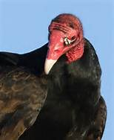
Biodiversity
1. What are some of the issues
that vultures face? (at least 5)
2. What are some of the ecological impacts of the vulture decline?
- financial?
3. Design a well-thought out plan to protect the vulture. What would you need to support your plan?

