Slide 1
Levels of Organization
Tissues
Cells
Organism
Organs
Organ System

Slide 2
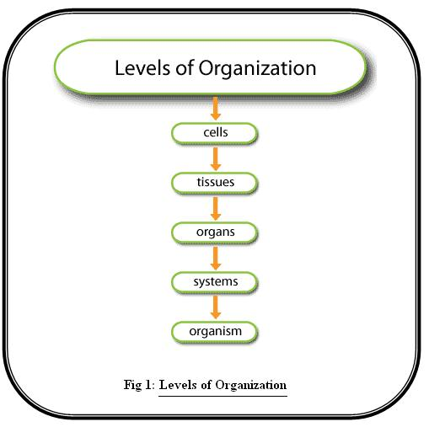

Slide 3
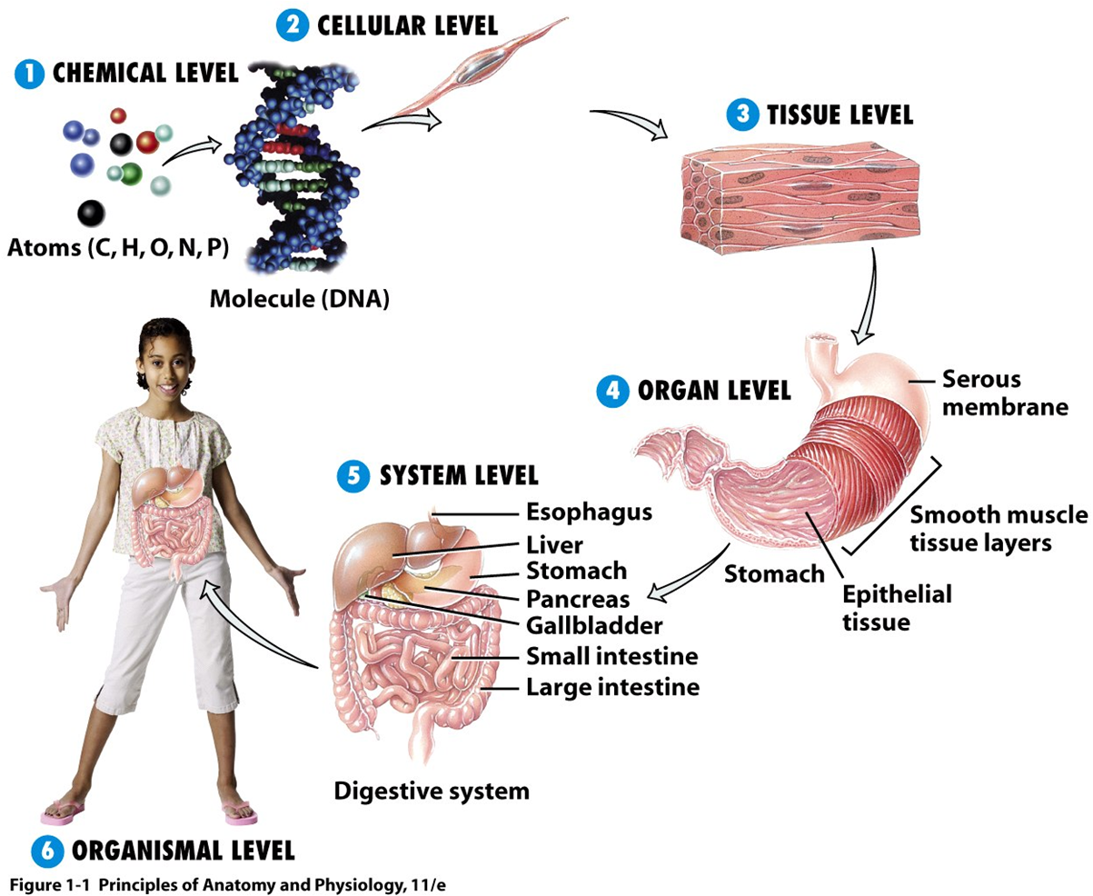

Slide 4
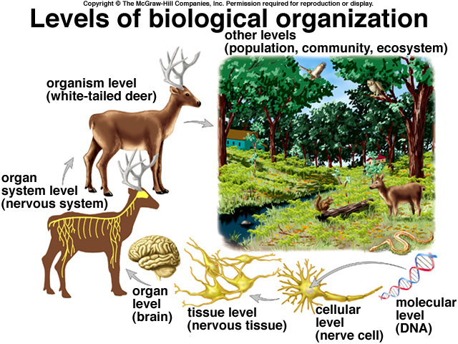

Slide 5
Organ System
There are 11 organ systems that work in harmony make up the Human Body

Slide 6
Homeostasis
Maintaining relatively constant body conditions (“Steady State”)
In other words, keeping certain balances within your body.
Ex. Body Temperature, Blood sugar level, water level.

Slide 7
Homeostasis
Feedback Loop
the process of monitoring the conditions within our body and responding in such a way to maintain homeostasis
(Positive & Negative feedback)

Slide 8
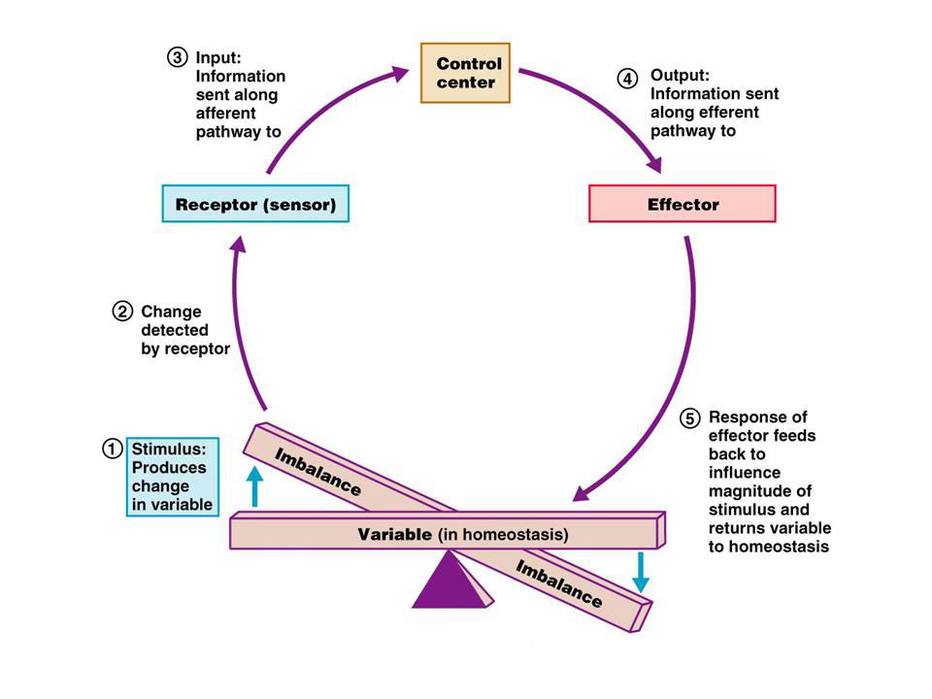

Slide 9
Homeostasis
Negative Feedback
Helps the body maintain homeostasis by preventing certain body conditions (ex. body temperature) from moving too far away from a certain set point. (98. 6ºF)
It works to counteract a change in body conditions

Slide 10
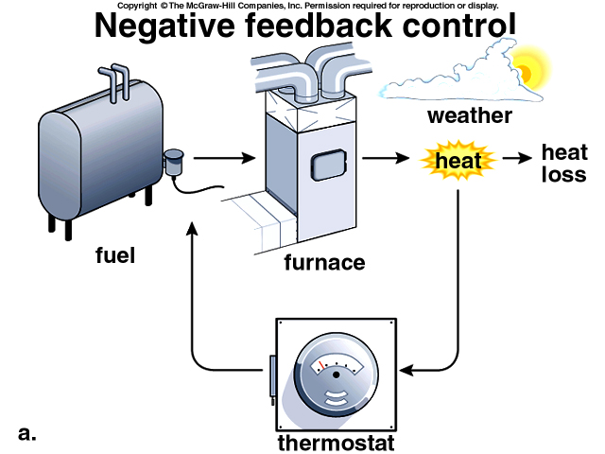

Slide 11
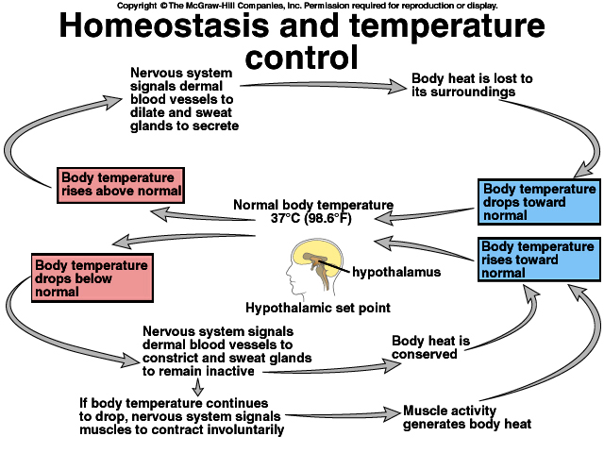
See Life CD 40.1

Slide 12
Homeostasis
Positive Feedback
Causes the body to set forth a chain of reactions that continue until completion.
Ex. Childbirth

Slide 13
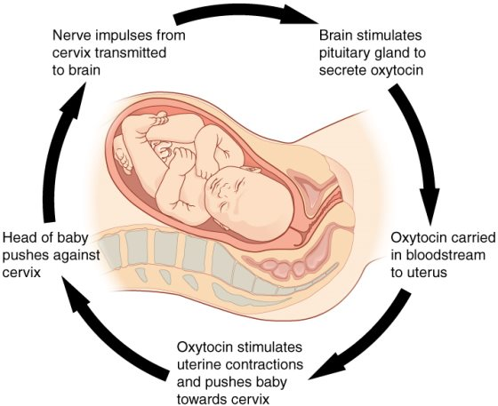

Slide 14
Homeostasis
Our body uses the Nervous and Endocrine system to maintain homeostasis.
Nervous System… Electrical signals from the brain & nerves
Endocrine System…Chemical signals from glands that release hormones

Slide 15
Integumentary System (Skin)
Protection from surroundings
Regulates body temperature

Slide 17
Skeletal System
Support for muscles
Determines shape
Production of:
Red Blood Cells
White blood cells
Platelets

Slide 18
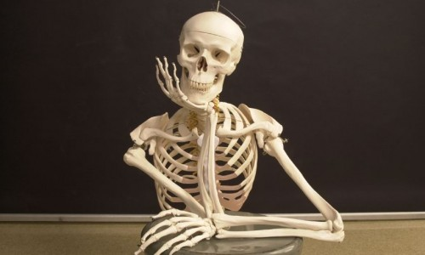
Skeletal System

Slide 19
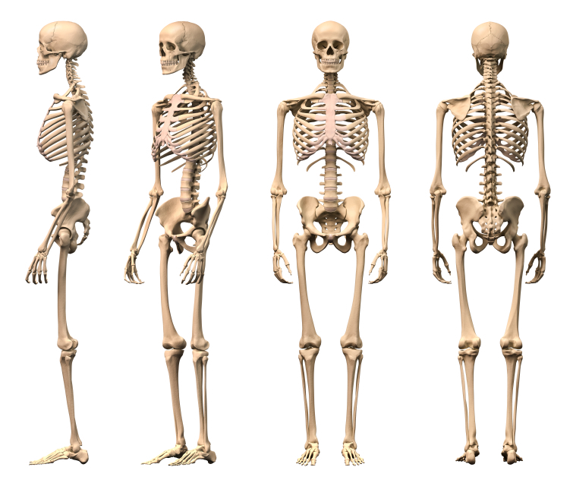

Slide 20
Muscular System
Allows for movement
Maintains posture
Regulates temperature

Slide 21
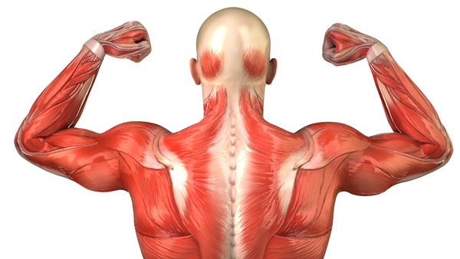
Muscular System

Slide 22
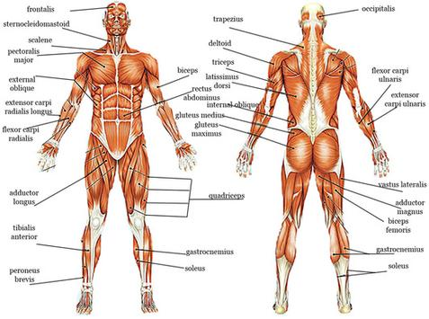

Slide 23
Nervous System
Receives & processes information
Stimulates muscles to react
Regulates internal functions

Slide 24
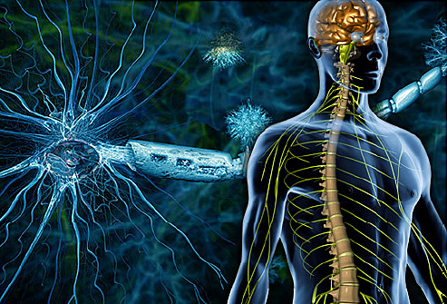

Slide 25
Endocrine System
Secretes hormones
Controls activities of other body structures

Slide 26
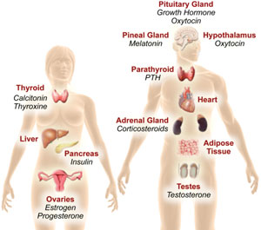

Slide 27
Digestive System
Converts food to energy
Eliminates unused materials

Slide 28
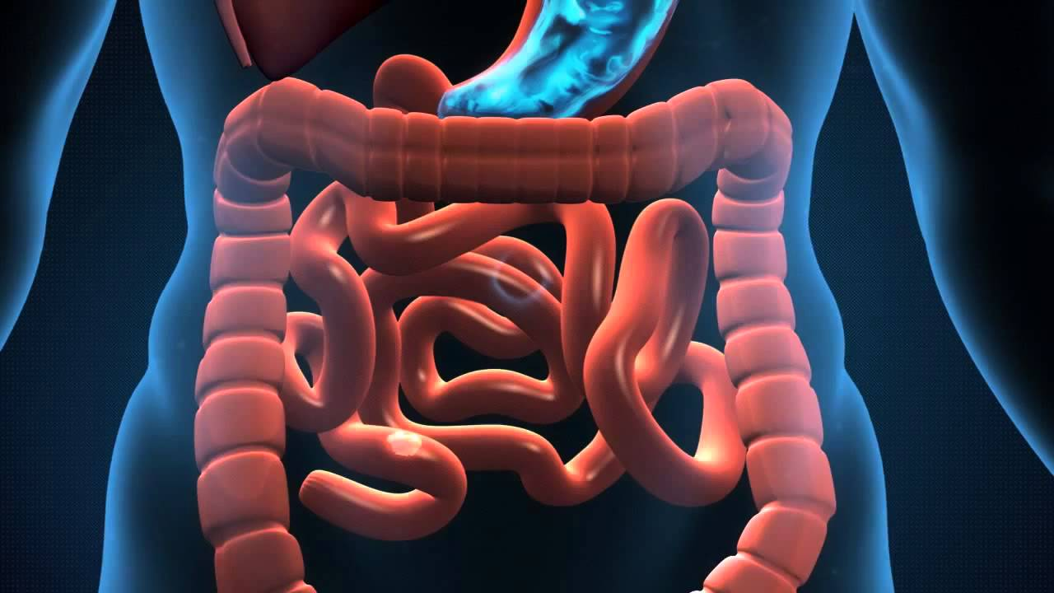
Digestive System

Slide 29
Respiratory System
Put Oxygen (O₂) into the blood
Take Carbon Dioxide (CO₂) out of the blood

Slide 30
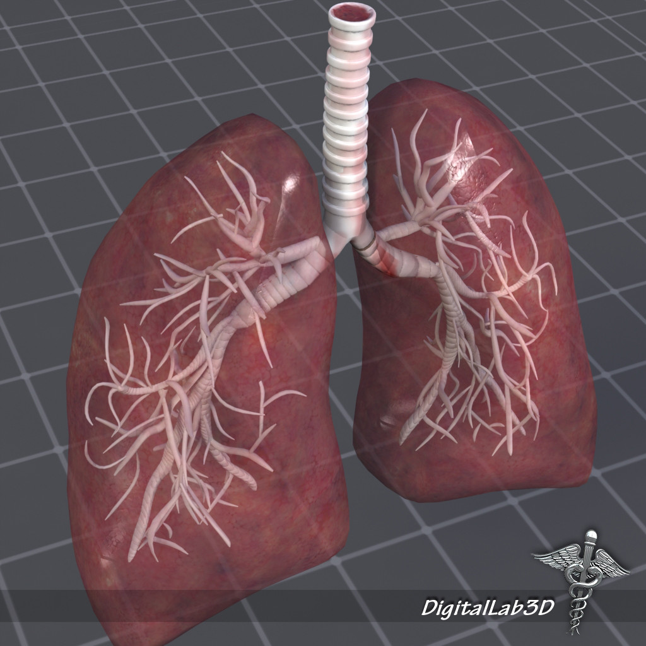

Slide 31
Circulatory System
Transports O₂ & nutrients to ALL cells of the body
Carries off CO₂ & waste products from the cells

Slide 32
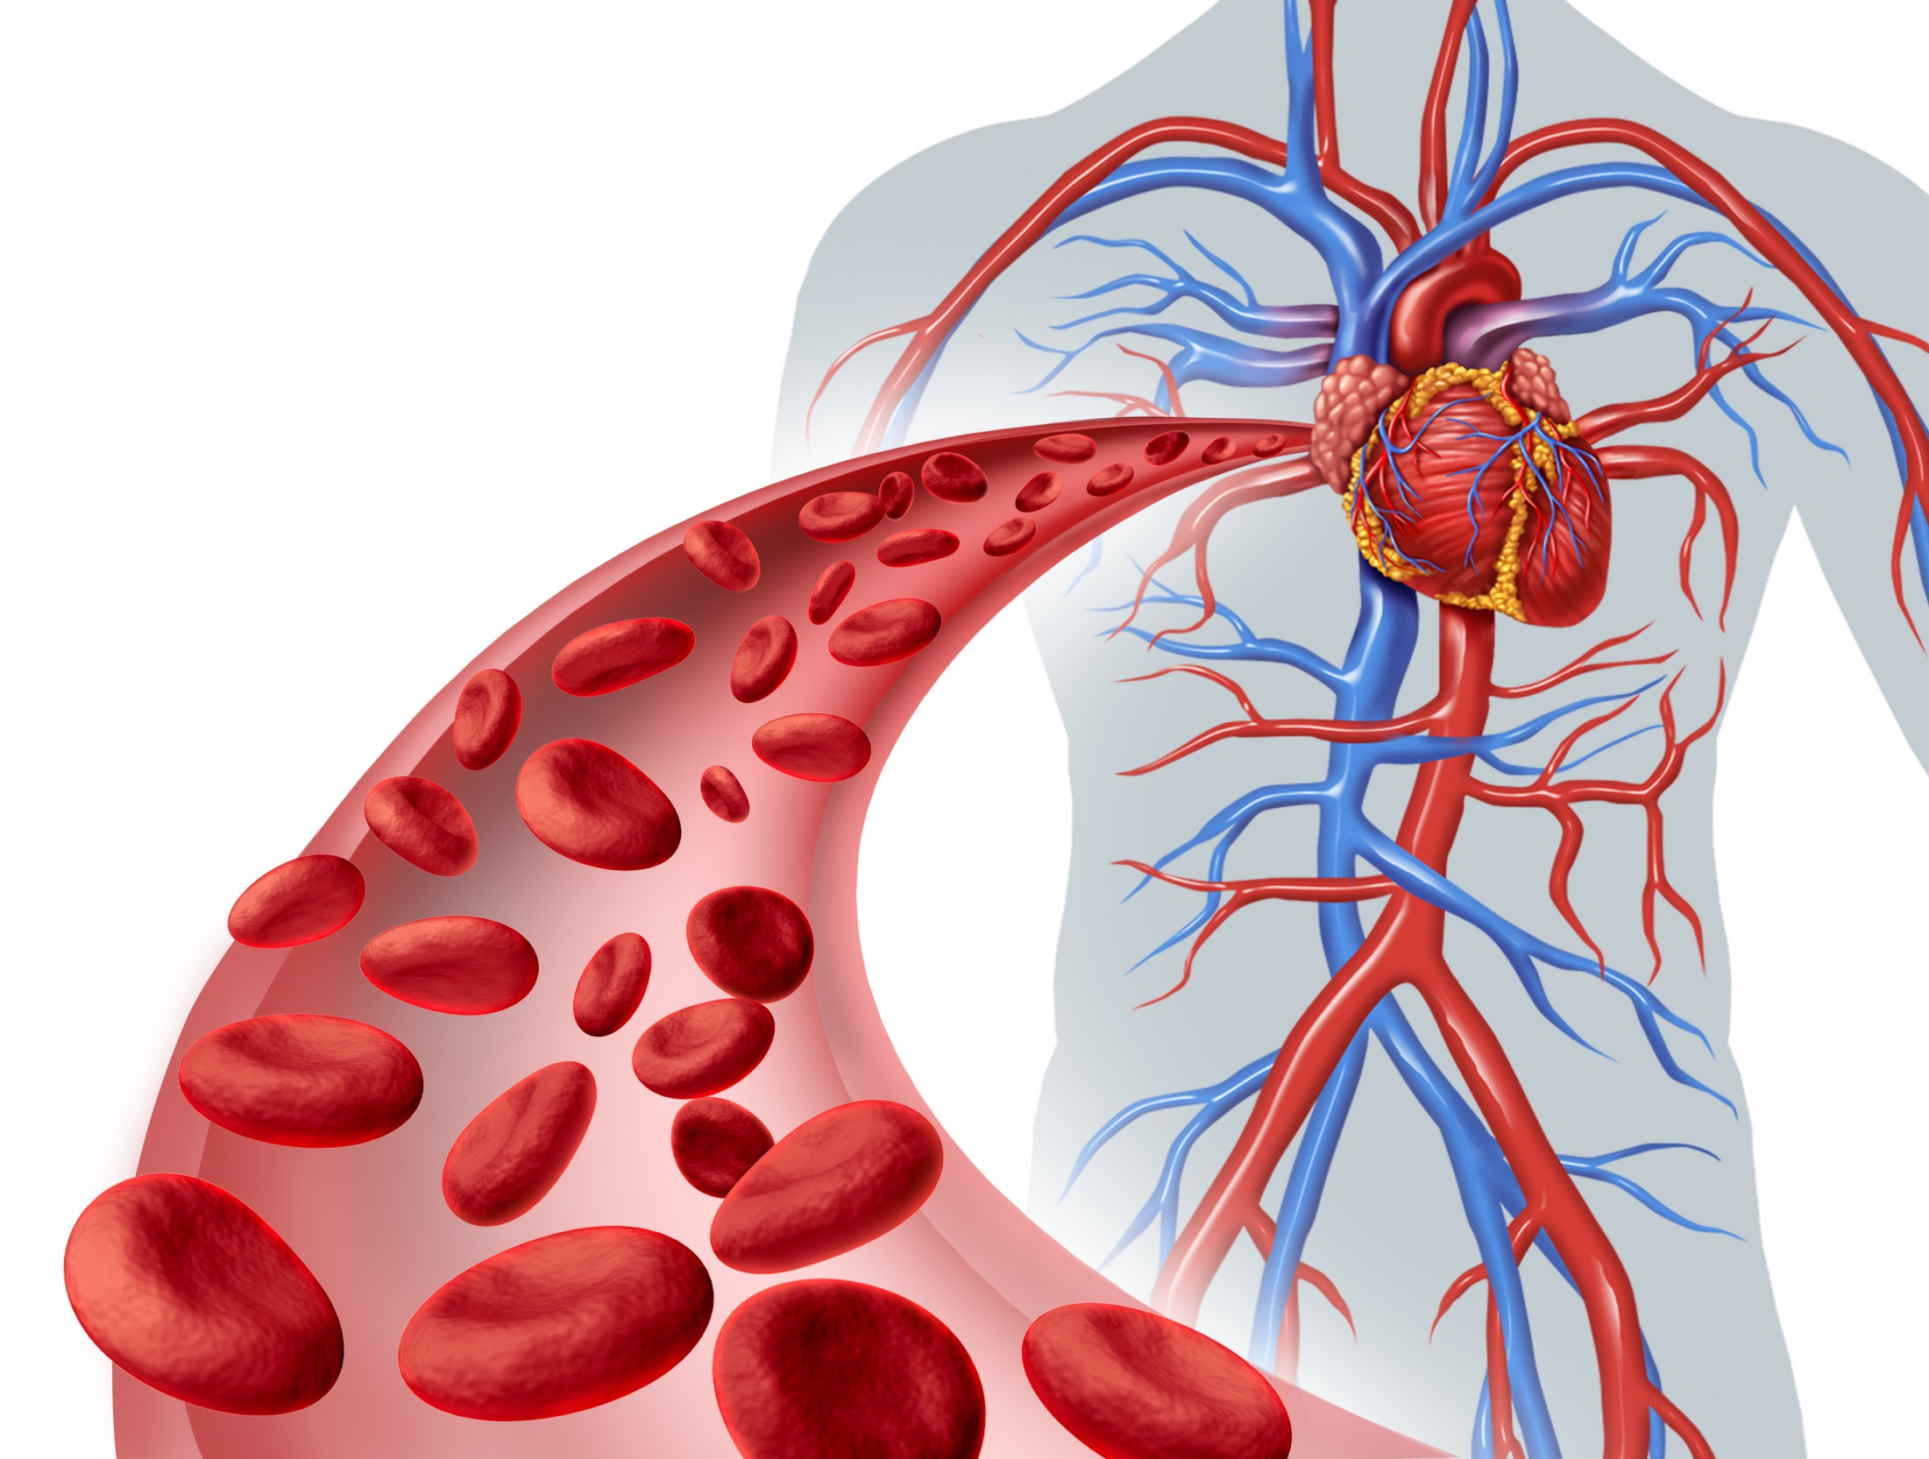

Slide 33
Lymphatic System
Returns fluid to the blood
Defends body against infection

Slide 34
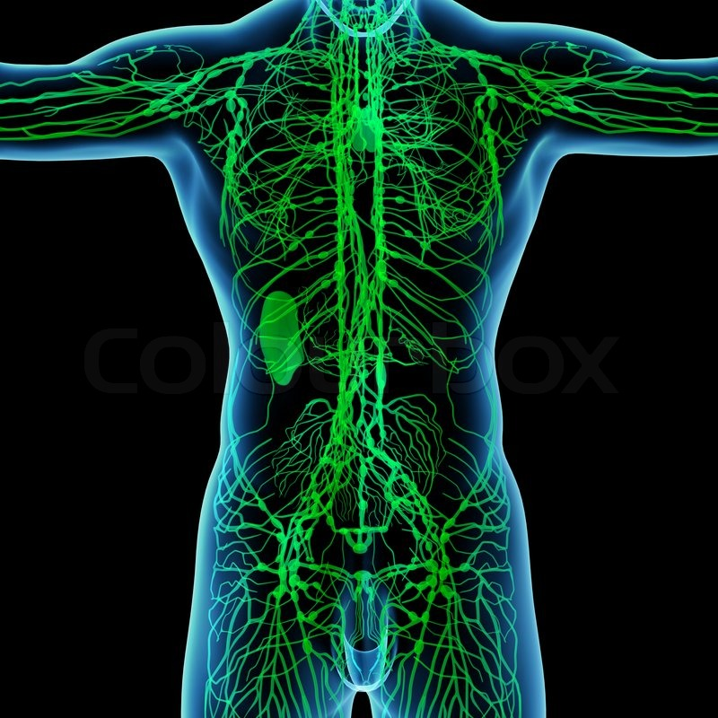

Slide 35
Urinary System
Removes waste from your blood
Excretes waste out of your body

Slide 36
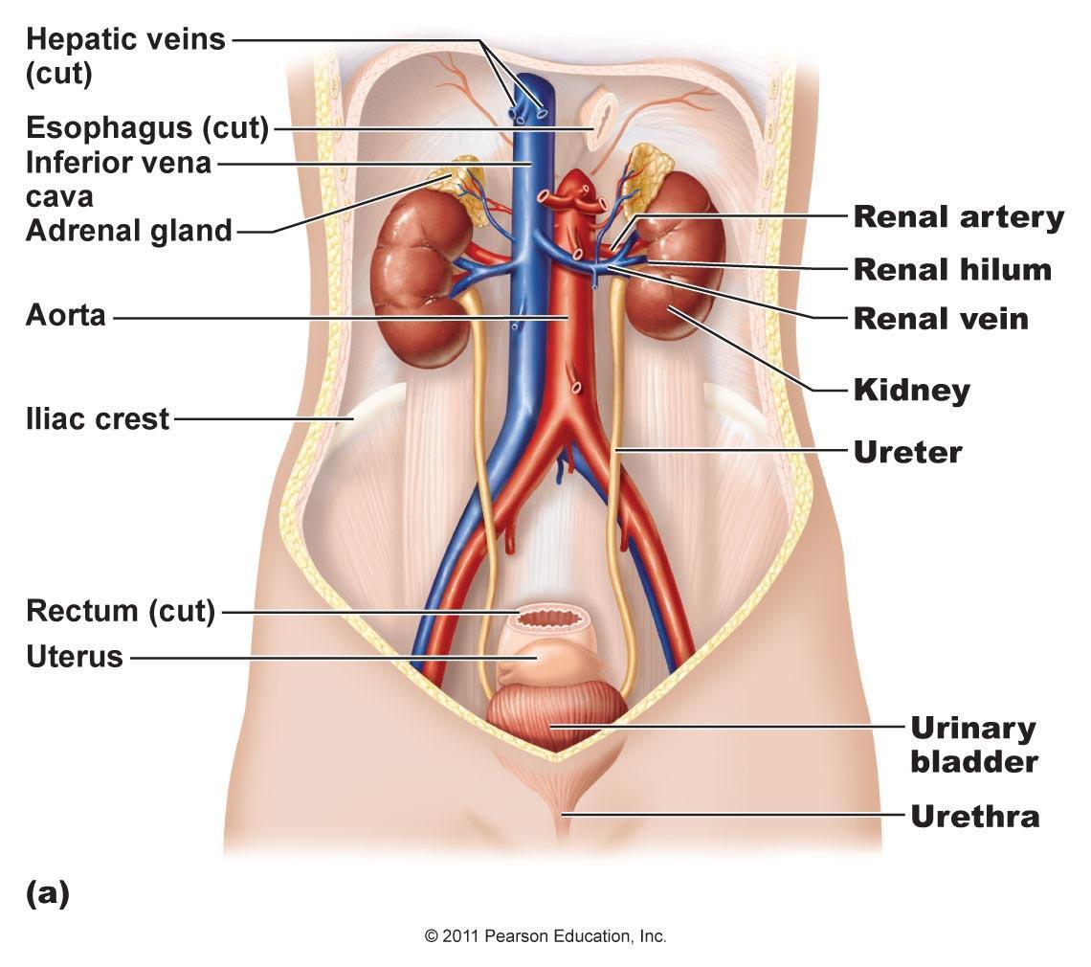

Slide 37
Reproductive System
Reproduce the next generation
Female – produce eggs
Males – produce sperm

Slide 38
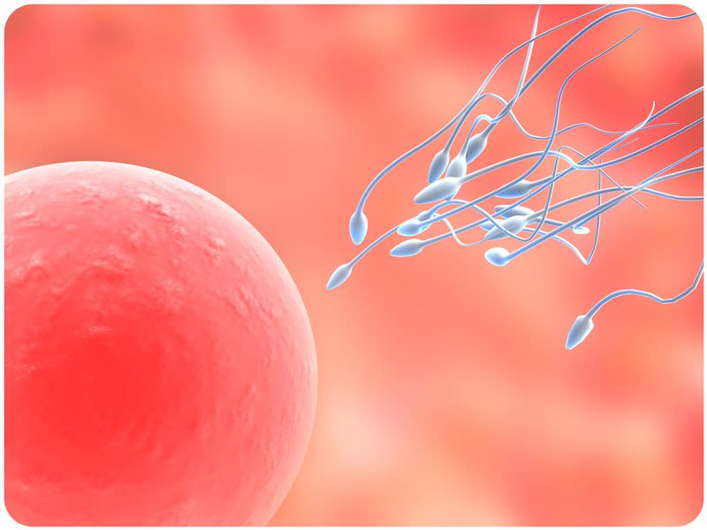

Slide 39
Chp 35 Bookwork
Read pp. 841-848
For the following Organs systems:
Tell what organs make them up
State their job or purpose
Give at least 2 interesting facts about that organ system (2 complete sentences.

Slide 40
Chp 35 Bookwork
Muscular
Integumentary
Circulatory
Immune
Lympatic
Respiratory
Digestive
Urinary
Endocrine
Reproductive

