Slide 1
The Characteristics of Life

Slide 2
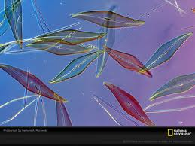
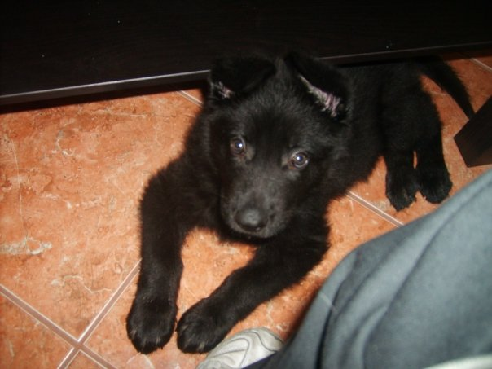
Characteristics of Life
1. Made of cells
Cell = Basic unit of all life
Unicellular vs. Multicellular

Slide 3
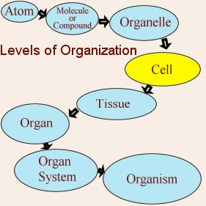
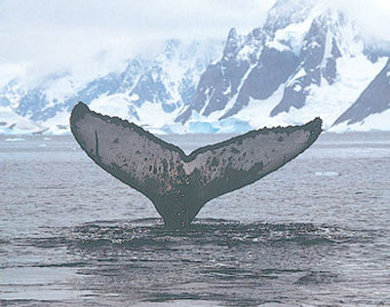
Characteristics of Life
2. Displays Organization
Each organized structure has a function

Slide 4
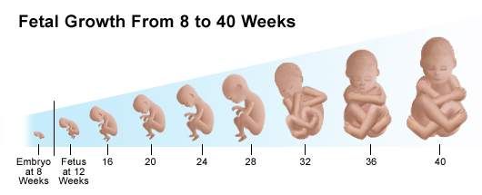
Characteristics of Life
3. Grows and Develops

Slide 5
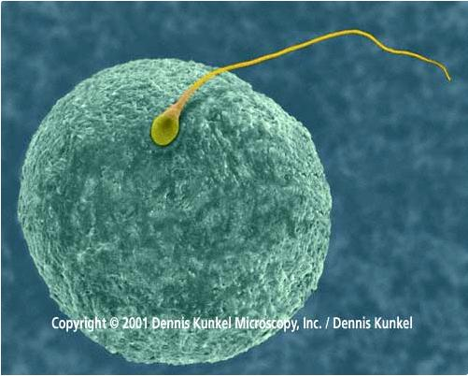
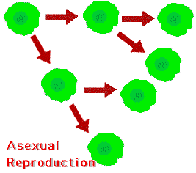
Characteristics of Life
Reproduces
Asexual vs. Sexual

Slide 6
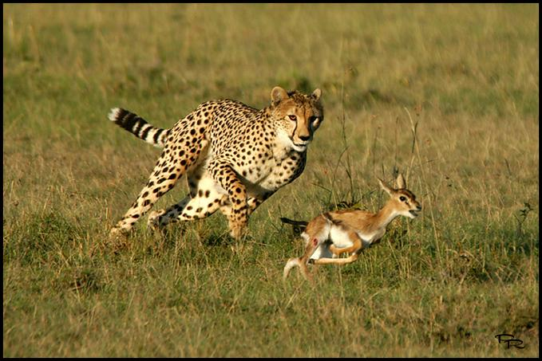
Characteristics of Life
5. Responds to Stimuli

Slide 7
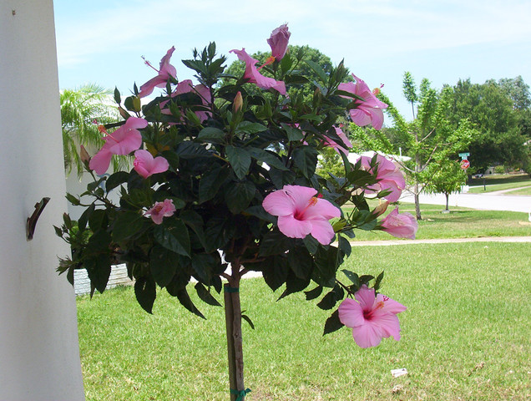
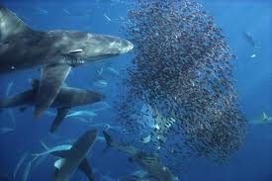
Characteristics of Life
6. Requires Energy
-Obtaining and using or making

Slide 8
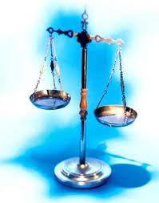
Characteristics of Life
7. Maintains Homeostasis- an internal balance
Food Intake
Temperature
Water Content

Slide 9
Characteristics of Life
8. Adaptations evolve over time

Slide 10
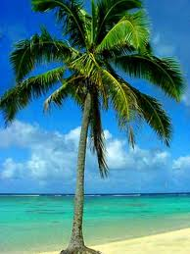
Branches of Biology
1. Biology -- The study of life
2. Botany -- The study of plants
3. Zoology -- The study of animals

Slide 11
Tools in Biology
International System of Units (SI)
SI Base Units
Length = meter (m)
Mass = gram (g)
Volume = liter (L)

