Slide 1
Biodiversity: Who cares?

Slide 2
Which do you like better?
A
B

Slide 3
Which do you like better?
A
B

Slide 4
Which do you like better?
A
B

Slide 5
Which do you like better?
A
B

Slide 6
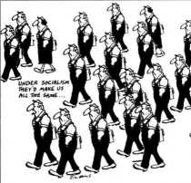
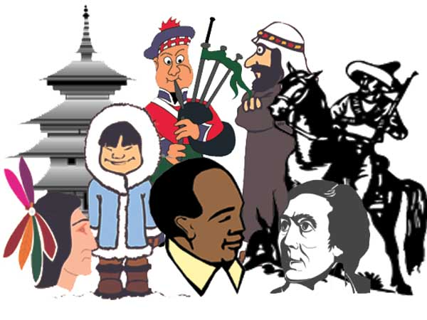
Which do you like better?
A
B

Slide 7
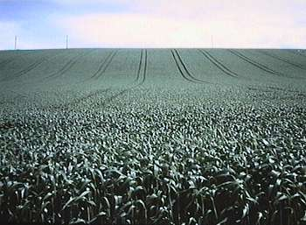
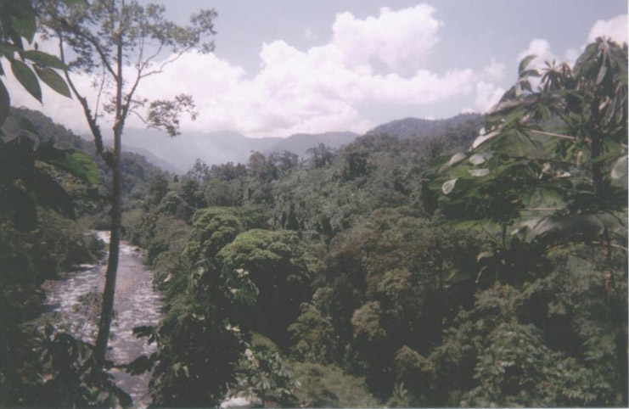
Which do you like better?
A
B

Slide 8
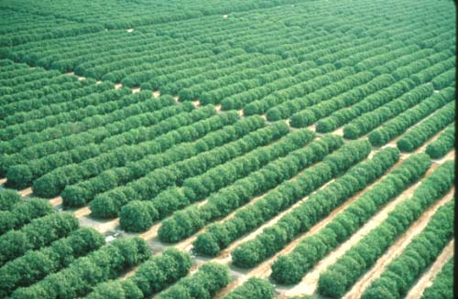
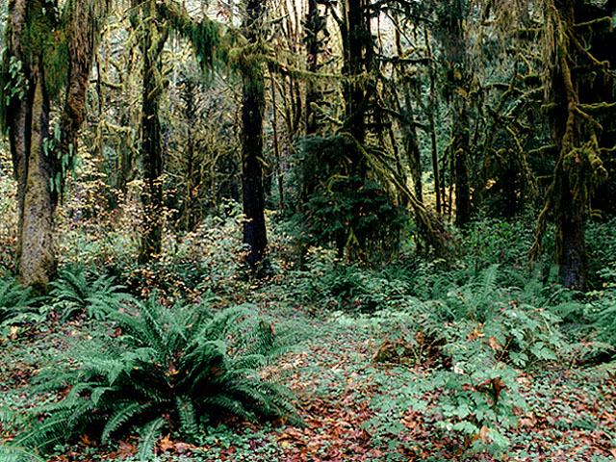
Which do you like better?
A
B

Slide 9
What do you think biodiversity means?

Slide 10
Biodiversity
What does “Bio” mean?
Life
Bio =

Slide 11
Biodiversity
What does “Diversity” mean?
Diversity = Variety

Slide 12
Biodiversity is the variety of life on Earth and the essential interdependence of all living things
Scientists have identified more than 2 million species. Tens of millions -- remain unknown
The tremendous variety of life on Earth is made possible by complex interactions among all living things including microscopic species like algae and mites.

Slide 13
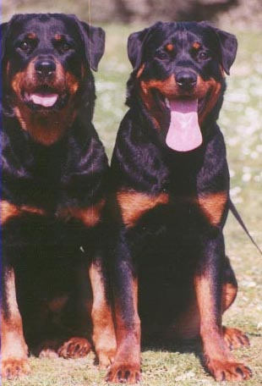
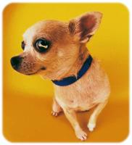
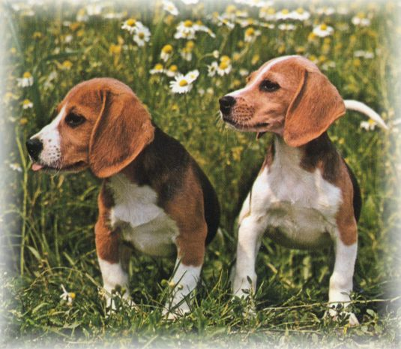
There are 3 components of biodiversity
Diversity of genes Chihuahuas, beagles, and rottweilers are all dogs—but they're not the same because their genes are different.
Chihuahua
Beagle
Rottweilers

Slide 14
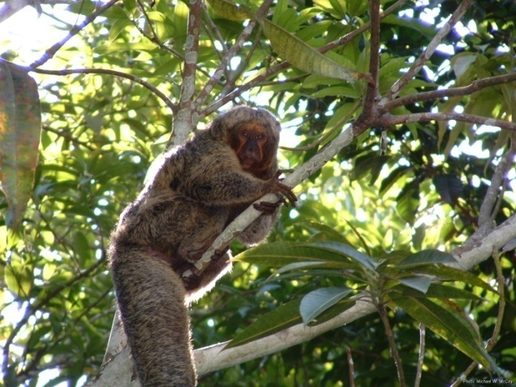
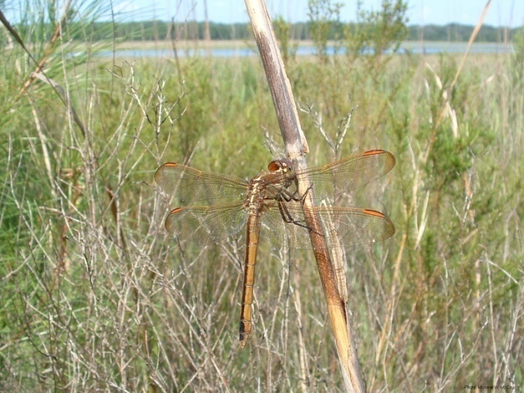
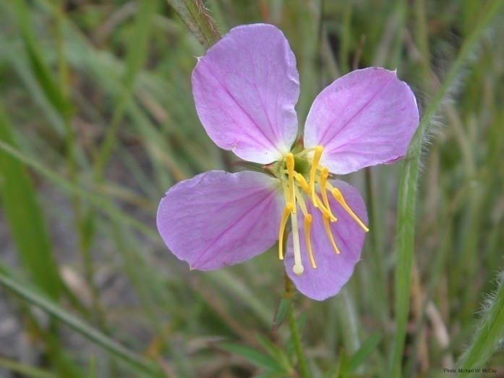
There are 3 components of biodiversity
Diversity of species For example, monkeys, dragonflies, and meadow beauties are all different species.
Saki Monkey
Golden Skimmer
Meadow Beauty

Slide 15
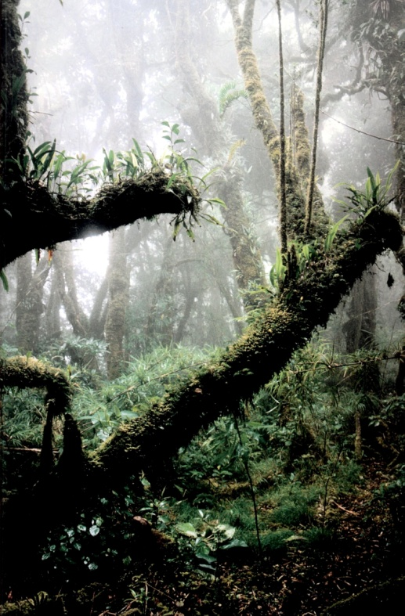
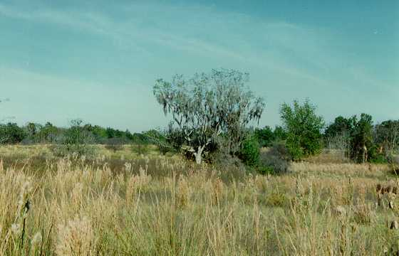
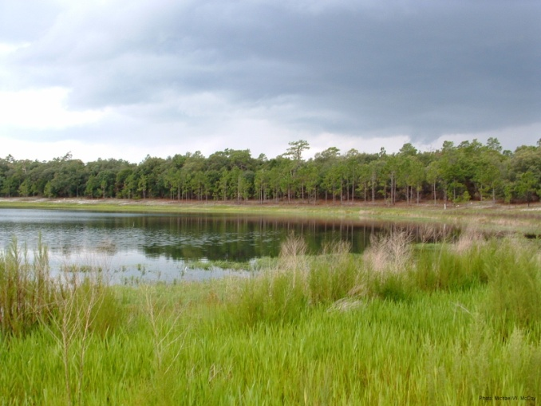
There are 3 components of biodiversity
Variety of ecosystems Prairies, Ponds, and tropical rain forests are all ecosystems. Each one is different, with its own set of species living in it.
Paines Prairie
Florida Sand hill Pond
Hoh Rain Forest

Slide 16
Which is more diverse?
A
B

Slide 17
Which is more diverse?
A
B

Slide 18
Which is more diverse?
A
B

Slide 19
Which is more diverse?
A
B

Slide 20
Which has more cultural diversity?
A
B

Slide 21
Which has more biodiversity?
A
B

Slide 22
Which has more biodiversity?
A
B

Slide 23
Biodiversity has Intrinsic Value
Intrinsic Value = Something that has value
in and of itself

Slide 24
Biodiversity also has utilitarian Value
Utilitarian Value = the value something has as a means to another’s end.
Utilitarian values include:
Goods
Services
Information

Slide 25
What do we get from biodiversity?
Oxygen
Food
Clean Water
Medicine
Aesthetics
Ideas

Slide 26
Should we be concerned about biodiversity?
What we know: The Earth is losing species at an alarming rate
Some scientists estimate that as many as 3 species per hour are going extinct and 20,000 extinctions occur each year.
when species of plants and animals go extinct, many other species are affected.

Slide 27
Threats to biodiversity
Habitat destruction
Pollution
Species Introductions
Global Climate Change
Exploitation

Slide 28
Habitat Destruction
The clearing of tropical rain forests has a direct impact on global biodiversity.
Since so many species live in the rainforests, the destruction of this habitat can cause many species around the world to become extinct

Slide 29
Pollution
Pollution changes the composition of the water, the air and the soil

Slide 30
Species Introductions
Plants and animals can be either intentionally or accidentally introduced and can change interactions and habitats.

Slide 31
Global Climate Change

Slide 32
Exploitation

